Slide 1


Welcome to Session 3: AI Empowerment Series
by Spencer Merrill

Slide 2
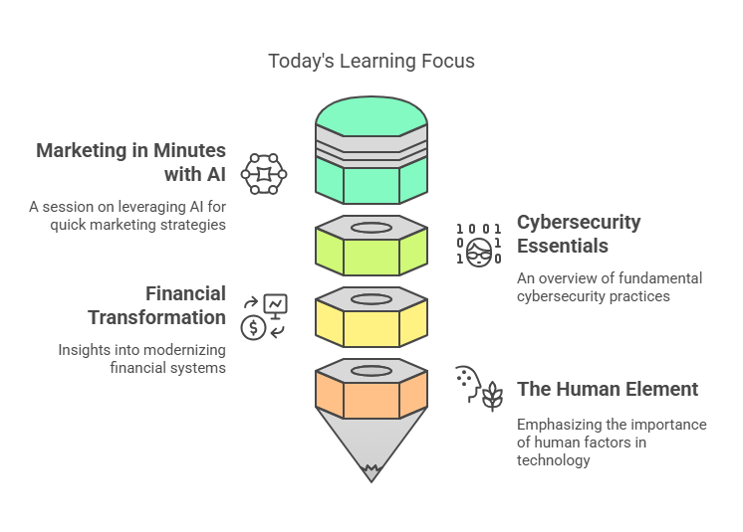
Today's Journey
1
Marketing in Minutes with AI
2
Cybersecurity Essentials
3
Financial Transformation
4
The Human
Element

Slide 3
Marketing in Minutes with AI
Understanding Your Audience
Competitive Analysis
Content Creation
Campaign Management
Generate engaging and relevant content for your website, social media, and email campaigns using AI-powered writing assistants and content generators.
Leverage AI-powered tools to analyze your target audience demographics, interests, and behaviors to tailor your marketing efforts effectively.
Gain valuable insights into your competitors' strategies, strengths, and weaknesses using AI tools for market research and competitive benchmarking.
Optimize your marketing campaigns for better performance using AI-powered analytics and automation tools for tracking, optimization, and reporting.

Slide 4

Target Audience Analysis
Data Collection
AI-Powered Insights
Gather data from various sources like website analytics, social media interactions, and customer surveys.
Leverage AI tools to analyze the data, identify patterns, and generate insights about your audience's demographics, interests, and behaviors.
Targeted Marketing
Example
Use the insights to create targeted marketing campaigns that resonate with your audience's needs and preferences.
A bakery uses AI to analyze customer purchase history and identify that they have a preference for vegan options, leading them to develop and promote a new line of vegan pastries.

Slide 5
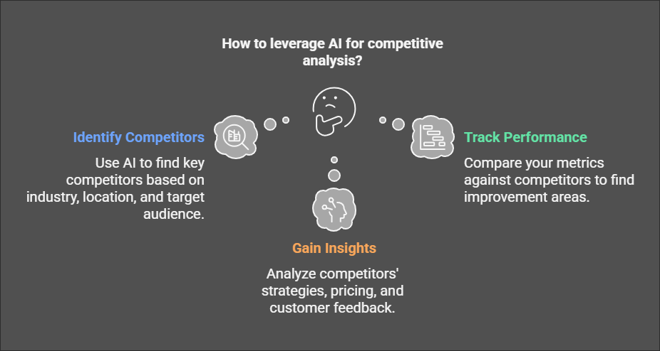
Competitive Analysis

Slide 6




Content Creation
Brainstorming
Writing
Use AI to generate content ideas, outlines, and drafts based on your target audience and keywords.
AI writing assistants can help you write engaging blog posts, social media captions, emails, and even website copy.
Visuals
Generate images, videos, and infographics using AI tools to enhance your content and make it more visually appealing.

Slide 7
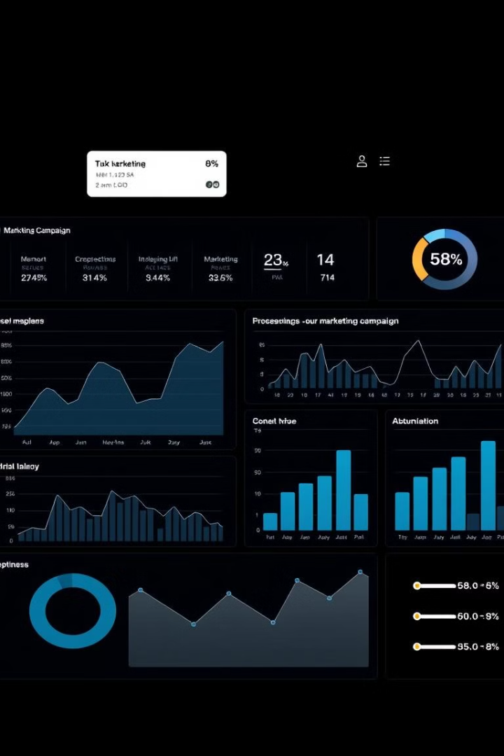
Campaign Management
1
Campaign Planning
Use AI to plan and schedule your marketing campaigns across different channels, based on your target audience and campaign objectives.
2
Campaign Execution
Automate your campaign execution using AI tools to streamline your workflow and save time on repetitive tasks.
3
Campaign Monitoring
Track your campaign performance using AI-powered analytics to identify areas for improvement and optimize your strategies.

Slide 8




Staying Safe in the Digital Age
1
Cybersecurity
2
Threat Detection
3
Prevention Strategies
4
Best Practices

Slide 9
Understanding Cyber Threats
Common Threats
Emerging Threats
Social Engineering Attacks
Business Email Compromise
Data Breaches
Cloud Security Threats
Ransomware
Deepfakes
Identity Theft

Slide 10

Building a Strong Defense
1
Software Updates
2
Strong Passwords
Patch vulnerabilities promptly.
Use unique, complex passwords.
3
Multi-Factor Authentication
4
Employee Training
Educate users on best practices.
Add an extra layer of security.

Slide 11




Deepfake Awareness
What Are Deepfakes?
AI-generated videos that manipulate real footage to make it appear that someone is saying or doing something they didn't.
Detection Methods
Look for inconsistencies in facial expressions, lighting, and background details that may indicate a deepfake.
Prevention Strategies
Be cautious about videos that appear too perfect or seem out of character for the person depicted.

Slide 12




Deepfake Detection and Prevention
Visual Analysis
Audio Analysis
Look for inconsistencies in eye movement, lighting, and facial features.
Listen for irregularities in speech patterns, lip sync issues, and audio quality.
Prevention Strategies
Verification protocols
Authentication systems
Digital signatures

Slide 13

Phishing Prevention: Stay Vigilant
Email Phishing
Beware of spoofed sender addresses, urgent payment requests, and account verification scams.
Spear Phishing
Be cautious of targeted attacks that use personal information and exploit business contexts.
Vishing
Protect yourself from phone-based scams, tech support fraud, and banking scams.

Slide 14
Best Practices for safety:

Slide 15

The Human Element
1
2
3
Collaboration
Ethical Considerations
Continuous Learning
AI tools should be used to enhance and support human decision-making, not replace it entirely.
It's crucial to ensure that AI tools are used responsibly and ethically, respecting privacy, fairness, and transparency.
Stay informed about the latest developments in AI and its applications to harness its power effectively and responsibly.

Slide 16
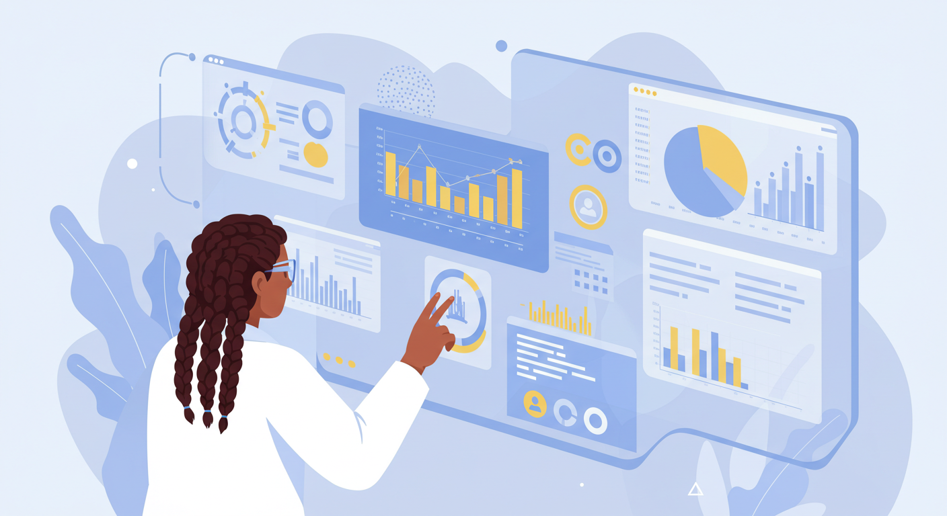
The Future? Human-in-the-loop.
is a: system where humans actively participate in the decision-making process of an artificial intelligence (AI) system, providing feedback and oversight to ensure accuracy and reliability, rather than letting the AI operate entirely autonomously

